Slide 1
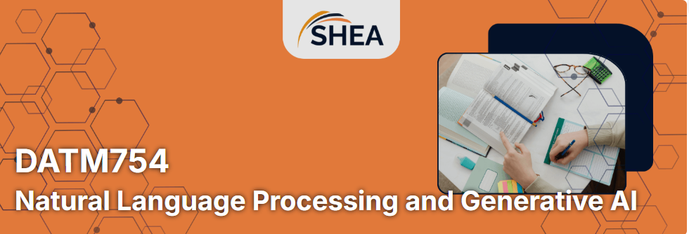
DATM754 Natural Language Processing and Generative Artificial Intelligence
Week 3: Vector Space Models: BoW, TF-IDF, N-grams
Dr. Farshid Keivanian

Slide 2
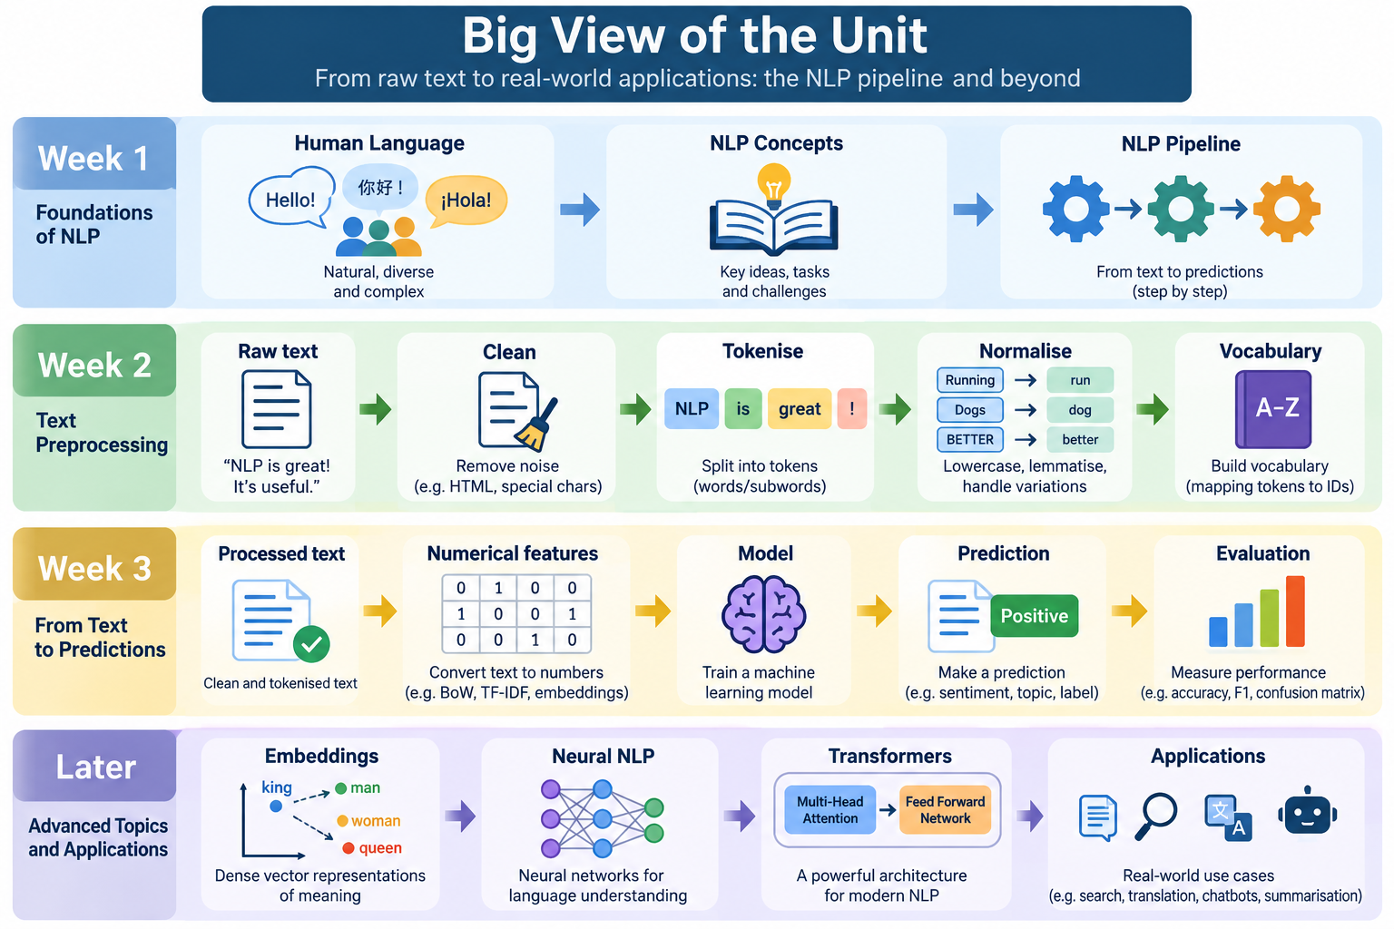

Slide 3
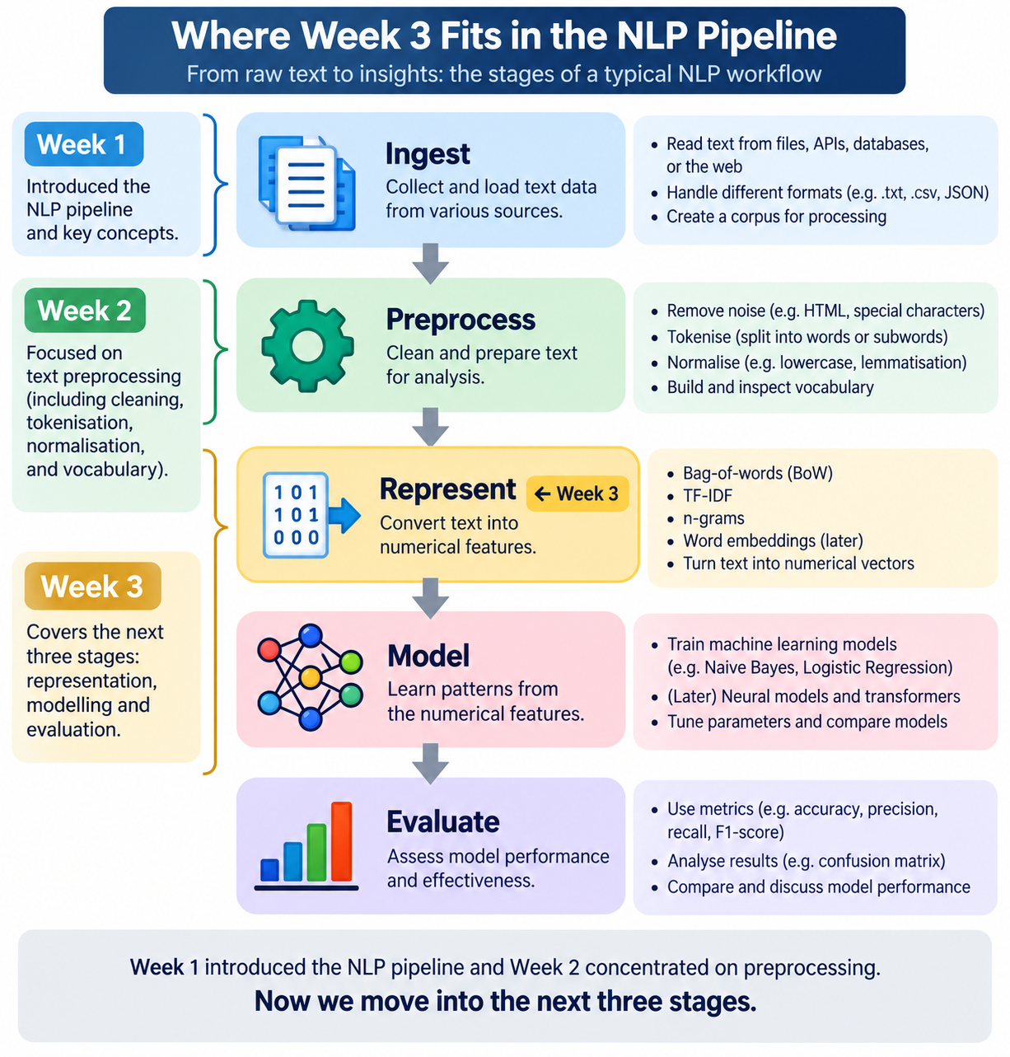
Where Week 3 Fits in the NLP Pipeline

Slide 4
Week 3 Learning Outcomes
By the end of Week 3, students should be able to:
explain why text must be converted to numbers;
explain Bag of Words in simple terms;
explain TF-IDF in simple terms;
distinguish BoW from TF-IDF;
explain unigram, bigram and trigram features;
use CountVectorizer;
use TfidfVectorizer;

Slide 5
Week 3 Learning Outcomes
perform a simple train/test split;
train Multinomial Naive Bayes;
train Logistic Regression;
calculate and interpret accuracy, precision, recall and F1;
read a confusion matrix;
compare baseline models;
explain how Week 3 connects to Assessment 2.

Slide 6
Assessment 1 and Assessment 2 — How They Connect
Assessment 1 asks:
Can you prepare text correctly and explain your preprocessing choices?
You focus on:
cleaning,
tokenisation,
normalisation,
vocabulary inspection,
stopword policy,
rare-token policy,
reproducibility,
and explaining why your choices matter.
You do not build a classifier or language model in Assessment 1.

Slide 7
Assessment 1 and Assessment 2 — How They Connect
Assessment 2 asks:
Can you represent text meaningfully, compare models fairly, evaluate the results, and explain why one approach behaves differently from another?
You will move beyond preprocessing into:
Word2Vec embeddings,
CBOW or Skip-gram,
negative sampling,
FastText or TF-IDF comparison,
document vectors,
Logistic Regression or SVM,

Slide 8
Assessment 1 and Assessment 2 — How They Connect
intrinsic evaluation,
PCA/t-SNE visualisation,
accuracy and macro-F1,
runtime/model-size comparison,
interpretation,
failure analysis,
and a reflective mini-viva.

Slide 9
How Week 3 Fits
Week 3 is an important bridge.
This week you learn:
Text → Numerical Features → Classifier → Evaluation
using:
Bag of Words,
TF-IDF,
n-grams,
Naive Bayes,

Slide 10
How Week 3 Fits
Logistic Regression,
precision,
recall,
F1,
confusion matrices.
These skills are especially useful because one A2 comparison option is:
TF-IDF + Logistic Regression vs Word2Vec-average + Logistic Regression
So Week 3 gives you the classical baseline side of that later comparison.

Slide 11
Assessment 1 Clarification
Mode) Individual
Weight) 30%
Submission
Notebook
500–600 word rationale
Viva
Coding? Yes
Students must build a reproducible preprocessing notebook.

Slide 12
Assessment 1 Clarification
Report? Yes, but short
A concise 500–600 word rationale, not a full research report.
Viva?
Yes
3–5 minutes
2–3 questions
worth 40% of A1

Slide 13
Assessment 1 Clarification
Assessment 1 — What You Need To Do
Step 1 — Choose a small corpus
Use LMS or approved external text.
If external:
cite the source,
note licence/attribution.

Slide 14
Assessment 1 Clarification
Step 2 — Build a reproducible pipeline
Use functions such as:
clean()
tokenise()
normalise()
Run the pipeline end-to-end.

Slide 15
Assessment 1 Clarification
Step 3 — Tokenisation
Choose a tokenizer.
Show at least one edge case such as:
URL,
emoji,
contraction,
hyphenation.
Step 4 — Normalisation
Choose: lemmatisation OR stemming
Do not use both as the final policy.
Show two example words.

Slide 16
Assessment 1 Clarification
Step 5 — Vocabulary
Report:
vocabulary size,
top tokens,
stopword policy,
rare-token policy.
Step 6 — Show examples
Include 3–5 before/after examples.

Slide 17
Assessment 1 Clarification
Step 7 — Rationale
Explain:
what you chose,
why,
what alternatives existed,
how choices could affect later models.

Slide 18
Assessment 1 Clarification
Step 8 — Viva preparation
Prepare examples for:
tokenisation,
stemming vs lemmatisation,
vocabulary,
ambiguity,
reproducibility.

Slide 19
Assessment 2 Clarification
Mode) Individual
Weight) 30%
Submission
notebook or .py
PDF report
mini-viva

Slide 20
Assessment 2 Clarification
Coding?
Yes
Substantial coding is required.
Report?
Yes
750–1000 words, ±10%
Viva?
Yes
An 8-minute reflective mini-viva

Slide 21
Assessment 2 Clarification
Assessment 2 — Main Structure
Section A — Compulsory
A1. Data & Preprocessing
Explain:
dataset,
source,
size,
classes,
tokenisation,
cleaning,
stopword/symbol decisions.

Slide 22
Assessment 2 Clarification
A2. Intrinsic Embedding Evaluation
Train one model:
Word2Vec CBOW
or
Word2Vec Skip-gram
Then provide:
5 nearest-neighbour lists,
3 analogy examples,
1 PCA/t-SNE plot.

Slide 23
Assessment 2 Clarification
Section B — Choose ONE Option
Option 1
Word2Vec vs FastText
Use:
same corpus,
same split,
same comparison conditions.
Compare:
accuracy,
macro-F1,
training time,
model size.
Use LR/SVM with document vectors.

Slide 24
Assessment 2 Clarification
Option 2
TF-IDF + LR vs Word2Vec-average + LR
Use the same split for both.
Compare:
accuracy,
macro-F1,
runtime,
feature dimensionality.
This option connects directly to Week 3.

Slide 25
Assessment 2 Clarification
Section C — Reflection
Write 150–200 words on:
Why one model performed better.
One failure case.
One practical mitigation.

Slide 26
Assessment 2 Clarification
Assessment 2 — Mini-Viva Expectations
Students should be able to explain:
how they kept the comparison fair,
why one model performed differently,
one failure case,
how they would improve it,
why macro-F1 was reported,
one fairness or dataset limitation.
They should refer to their own table or figure, not give generic textbook answers.

Slide 27
Week 3 Is Important Bridge
Week 3 is an important bridge between Assessment 1 and Assessment 2.
Assessment 1: Can you prepare text correctly and explain your preprocessing choices?
Week 3: Can you turn text into numerical features, train a simple classifier and evaluate its performance?
Assessment 2: Can you compare richer text representations fairly, evaluate them using evidence, and explain why one approach performs differently from another?

Slide 28
Quick Week 2 Recall
Question
What did we do last week?
We:
cleaned text,
tokenised it,
considered stopwords,
chose stemming or lemmatisation,
inspected vocabulary,
explored n-grams.
Week 2 explicitly introduced vocabulary, rare tokens and n-grams as preparation for Week 3 feature representations.

Slide 29
Warm-Up Activity
Question
Can a machine-learning model directly calculate with these words?
Not directly.
Most classical machine-learning models expect numbers.
So we need to transform:
Words → Numbers
This process is called:
Vectorisation

Slide 30
Concept 1 — What Is Vectorisation?
Simple meaning:
Vectorisation converts text into numerical features.
Example:
"great battery"
could become something like:
[1, 1, 0, 0]
depending on the vocabulary.
The numbers tell the model which words or features are present.

Slide 31
Discussion — Why Numbers?
Question
Why not simply give Logistic Regression the sentence:
"The phone is excellent"
Because classical models calculate using numerical inputs.
We first need to represent the sentence as numbers.

Slide 32
Simple Vocabulary Example
Suppose our entire corpus is:
great battery
poor battery
great camera
Vocabulary:
battery
camera
great
poor
We now have four possible features.

Slide 33
Turn One Sentence into a Vector
Feature | Position
battery | 1
camera | 2
great | 3
poor | 4
Vocabulary:
Sentence: great battery
Vector: [1, 0, 1, 0]
Meaning:
battery = 1
camera = 0
great = 1
poor = 0

Slide 34
Discussion Question
What would:
poor battery
become?
[1, 0, 0, 1]

Slide 35
Discussion Question
Question
What information have we lost?
Simple Bag of Words normally loses:
word order,
grammar,
deeper meaning.
That limitation is important.

Slide 36
Concept 2 — Bag of Words
Bag of Words asks:
Which words occur, and how many times?
It usually does not care about word order.
Example:
"good good battery"
may become:
good = 2
battery = 1

Slide 37
Why Is It Called a “Bag”?
Imagine putting the words into a bag.
Sentence: “The battery is really good”
Bag:
the
battery
is
really
good
We count the contents.
We generally ignore the original sentence structure.

Slide 38
Interactive Question
Compare:
“dog bites man”
and
“man bites dog”
Question
Could basic Bag of Words represent these similarly?
Yes.
They contain the same words.

Slide 39
Interactive Question
Question
Is their meaning the same?
No.
This shows one limitation of simple BoW.

Slide 40
Concept 3 — CountVectorizer
In Python, scikit-learn provides:
from sklearn.feature_extraction.text import CountVectorizer
This can:
identify vocabulary;
count terms;
create a numerical matrix.

Slide 41
First Week 3 Coding Activity
Use a very small dataset:
corpus = [
"great battery life",
"poor battery life",
"great camera",
"poor camera quality"
]

Slide 42
First Week 3 Coding Activity
Then:
from sklearn.feature_extraction.text import CountVectorizer
vectorizer = CountVectorizer()
X = vectorizer.fit_transform(corpus)
print(vectorizer.get_feature_names_out())
print(X.toarray())

Slide 43
Before Running the Code
Question
Which vocabulary words do you expect?
Possible answer:
battery
camera
great
life
poor
quality

Slide 44
Before Running the Code
Question
Which word will appear in more than one document?
Possible answers:
battery
camera
great
poor
life
Then run the code.

Slide 45
After Running the Code
Question 1
What does each row mean?
One document.
Question 2
What does each column mean?
One vocabulary feature.
Question 3
What does the number 2 mean?
The word appeared twice in that document.

Slide 46
Concept 4 — The Document-Term Matrix
A simplified example:
Document | battery | camera | great | poor
Great battery | 1 | 0 | 1 | 0
Poor battery | 1 | 0 | 0 | 1
Great camera | 0 | 1 | 1 | 0
This is a document-term matrix.
Documents = rows.
Terms/features = columns.

Slide 47
Industry Case Study — Australian Customer Reviews
Imagine an Australian telecommunications company receives thousands of customer comments:
"Great mobile coverage"
"Poor customer support"
"Very expensive plan"
"Excellent network speed"

Slide 48
Industry Case Study — Australian Customer Reviews
The business wants to classify them as:
positive,
negative.
Question 1
What must happen first?
Text must be cleaned and converted into numerical features.

Slide 49
Industry Case Study — Australian Customer Reviews
Question 2
Could BoW help?
Yes.
Words such as:
great
poor
excellent
expensive
may provide useful signals.

Slide 50
But BoW Has a Problem
Suppose every document contains:
service
customer
company
These words may occur frequently but may not be very useful for distinguishing categories.
This motivates:
TF-IDF

Slide 51
Concept 5 — TF-IDF
TF-IDF means:
Term Frequency
How often does this word appear in this document?
Inverse Document Frequency
How unusual or distinctive is this word across the full collection?
Simple idea:
A word gets more importance if it is useful in one document but not common everywhere.

Slide 52
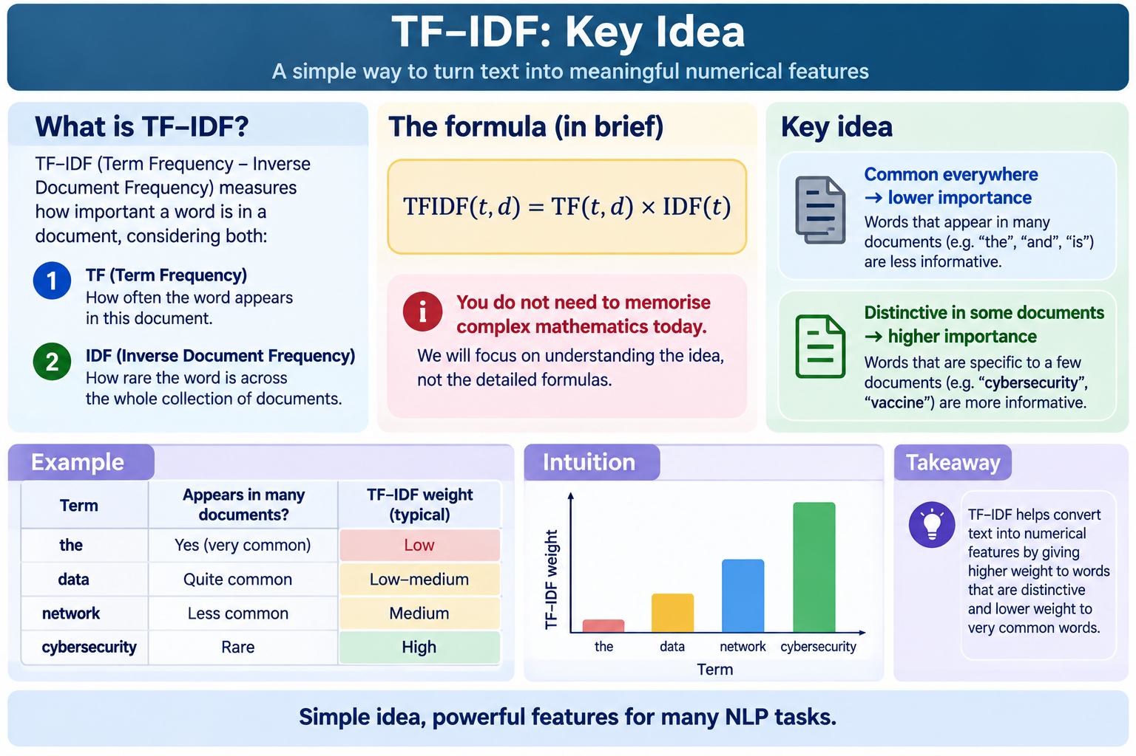
Do Students Need the Full Formula?

Slide 53
TF-IDF Example
Documents:
customer service was good
customer service was poor
customer service was terrible
The terms:
customer
service
appear everywhere.

Slide 54
TF-IDF Example
But:
good
poor
terrible
help distinguish the documents.
TF-IDF reflects this difference.

Slide 55
Discussion — BoW vs TF-IDF
Question 1
Which method uses raw counts?
Bag of Words.
Question 2
Which method gives lower importance to very common words?
TF-IDF.

Slide 56
Discussion — BoW vs TF-IDF
Question 3
Is TF-IDF always better?
No.
Performance depends on:
dataset,
task,
preprocessing,
model,
parameter choices.
The correct approach is usually to test and compare.

Slide 57
Python Practice — TF-IDF
from sklearn.feature_extraction.text import TfidfVectorizer
tfidf = TfidfVectorizer()
X = tfidf.fit_transform(corpus)
print(tfidf.get_feature_names_out())
print(X.toarray())

Slide 58
Interactive Prediction
Before running:
Question 1
Will the numbers still all be integers?
No.
TF-IDF produces weighted values.
Question 2
Will very common words usually receive the highest value?
Not necessarily.
Words that are more distinctive may receive greater weight.

Slide 59
Side-by-Side Comparison
Use the same corpus.
BoW
CountVectorizer()
TF-IDF
TfidfVectorizer()
What changed?
Vocabulary can remain similar.
The numerical values change.
BoW uses counts.
TF-IDF uses weighted importance.

Slide 60
Concept 6 — N-Grams
Students saw n-grams in Week 2, where they learned that:
unigram = one token,
bigram = two neighbouring tokens,
trigram = three neighbouring tokens.
Now we use them as features.

Slide 61
Why N-Grams Can Matter
Consider:
good
and:
not good
With unigram features:
not
good
With bigrams:
not good
The bigram preserves more local context.

Slide 62
Coding N-Grams
Unigrams:
CountVectorizer(ngram_range=(1,1))
Unigrams + bigrams:
CountVectorizer(ngram_range=(1,2))
TF-IDF with unigrams + bigrams:
TfidfVectorizer(ngram_range=(1,2))

Slide 63
Discussion Questions
Question
Why not use (1,5) immediately?
Because the feature space may become huge.
Longer n-grams:
occur less frequently,
create many features,
increase memory use,
may cause overfitting.

Slide 64
Concept 7 — Frequency Thresholds
Two useful options:
min_df=
and:
max_df=
Simple meaning
min_df
Ignore terms that occur too rarely.
max_df
Ignore terms that appear in too many documents.

Slide 65
Discussion Question
Suppose:
"xzabc99"
occurs once in 10,000 reviews.
Question) Should it always become a feature?
Not necessarily.
It could be noise.
But remember Week 2:
Rare terms can sometimes be important.
So frequency thresholds should be justified, not blindly applied.

Slide 66
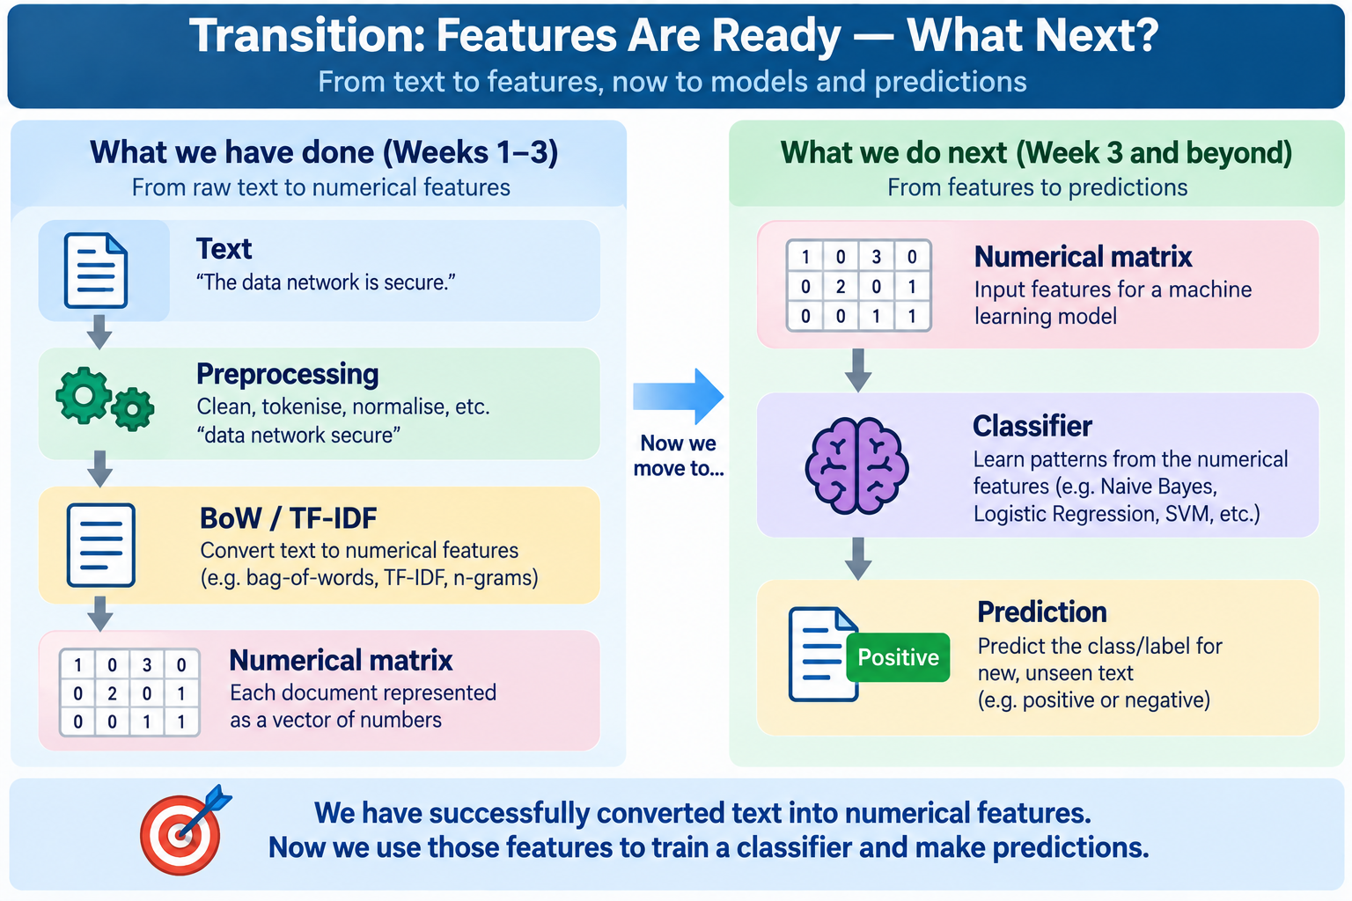
Transition: Features Are Ready — What Next?

Slide 67
Concept 8 — Text Classification
Classification means:
Assigning a label to text.
Examples:
Email
spam / not spam
Review
positive / negative
Support ticket
billing / technical / delivery
Cybersecurity alert
benign / suspicious

Slide 68
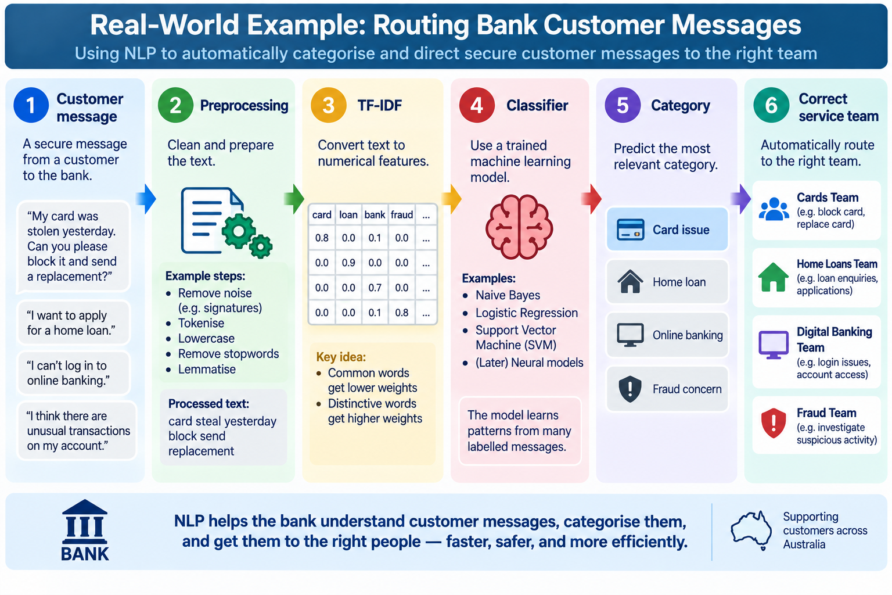
Australian Industry Case Study

Slide 69
Concept 9 — Training and Testing
A common mistake:
Train the model and evaluate it on the same data.
Why is that a problem?
Because the model has already seen those examples.

Slide 70
Analogy
Think about university study.
Training set
Practice questions.
Test set
Questions you have not seen before.
A good model should work on new data, not only memorise training examples.

Slide 71
Python — Train/Test Split
from sklearn.model_selection import train_test_split
X_train, X_test, y_train, y_test = train_test_split(
texts,
labels,
test_size=0.2,
random_state=42
)

Slide 72
Discussion
Question 1
What does test_size=0.2 mean?
20% goes to testing.
80% goes to training.
Question 2
Why use random_state=42?
It helps make the split reproducible.
That connects directly with the reproducibility skills developed in Assessment 1.

Slide 73
Important: Avoid Data Leakage
A good pipeline should learn vocabulary/feature weights from the training data, not secretly use information from the test set.
A simple solution:
scikit-learn Pipeline
Vectorizer → Classifier

Slide 74
Concept 10 — Multinomial Naive Bayes
Naive Bayes looks at how strongly words/features are associated with each class.
For example:
Positive reviews may commonly contain:
great
excellent
love
Negative reviews may commonly contain:
poor
terrible
bad
It uses probability to make a prediction.

Slide 75
Discussion
Question
Is the model unintelligent because it is called Naive Bayes?
No.
“Naive” refers to a simplifying assumption about features.
Despite being simple, Naive Bayes can be a useful baseline for text classification.

Slide 76
First End-to-End Classifier
from sklearn.pipeline import Pipeline
from sklearn.naive_bayes import MultinomialNB
from sklearn.feature_extraction.text import TfidfVectorizer
model = Pipeline([("tfidf", TfidfVectorizer()),("classifier", MultinomialNB())])
model.fit(X_train, y_train)
predictions = model.predict(X_test)

Slide 77
Ask Students Before Running
Question 1) Which steps are inside this pipeline?
TF-IDF converts text to features.
Naive Bayes uses those features for classification.
Question 2) Are we manually calculating TF-IDF?
No.
Scikit-learn does the numerical work.
We need to understand and justify the process.

Slide 78
Concept 11 — Logistic Regression
Despite the word regression, Logistic Regression is commonly used for classification.
Simple idea:
It learns weights for features and estimates which class is more likely.
For text:
"excellent"
might contribute toward positive.
"terrible"
might contribute toward negative.

Slide 79
Logistic Regression Pipeline
from sklearn.linear_model import LogisticRegression
model = Pipeline([("tfidf", TfidfVectorizer()),("classifier", LogisticRegression(max_iter=1000))])
model.fit(X_train, y_train)
predictions = model.predict(X_test)

Slide 80
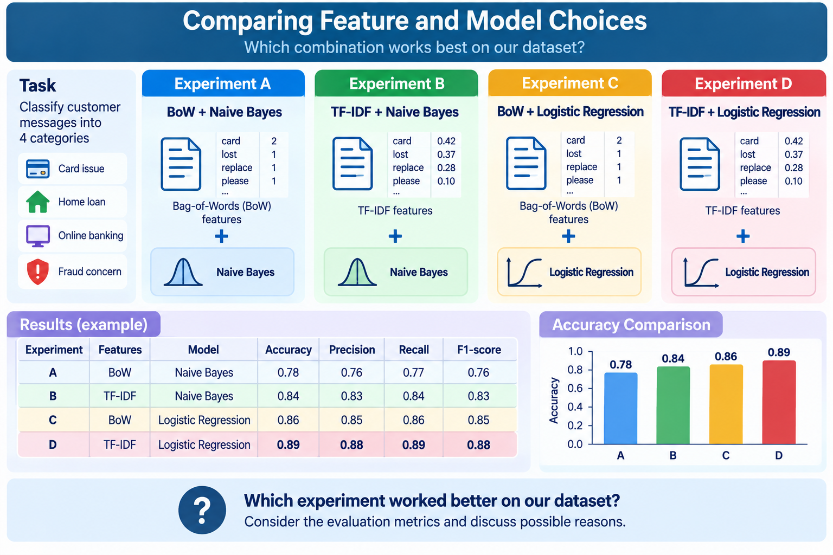
Week 3 Experiment

Slide 81
Concept 12 — Evaluation
A model producing predictions is not enough.
We need to ask:
How good are those predictions?
Common metrics:
Accuracy
Precision
Recall
F1-score
Confusion matrix

Slide 82
Accuracy
Simple meaning:
Out of all predictions, how many were correct?
Example:
90 correct out of 100
Accuracy:
90%

Slide 83
Discussion — Is Accuracy Enough?
Imagine:
95 normal transactions
5 fraud transactions
The model says:
Everything is normal
Accuracy:
95%
Question) Is that a good fraud detector?
No. It missed every fraud case. This is why we also need precision and recall.

Slide 84
Precission
Simple question:
When the model predicted this class, how often was it correct?
For spam detection:
Of everything predicted as spam, how much was really spam?

Slide 85
Recall
Simple question:
Of all the real examples of this class, how many did the model find?
For fraud detection:
Of all the real fraud cases, how many did our model detect?

Slide 86
F1-Score
Simple meaning:
A balance between precision and recall.
Useful when both matter.
You do not need to make Week 3 overly mathematical.
Students should understand what the metric means.

Slide 87
Discussion — Precision or Recall?
Medical screening
Missing a sick patient may be serious.
Which might be especially important?
Recall
Spam filter
Sending a legitimate important email to spam can be harmful.
Which might deserve special attention?
Precision
Key Point
The “best” metric depends on the problem.

Slide 88
Classification Report in Python
from sklearn.metrics import classification_report
print(classification_report(y_test, predictions))
Identify:
precision,
recall,
F1,
support.

Slide 89
Concept 13 — Confusion Matrix
A confusion matrix shows:
What did the model get right?
and:
What did it confuse?
Binary example:
 | Predicted Positive | Predicted Negative
Actual Positive | correct | missed
Actual Negative | false alarm | correct

Slide 90
Discussion
Suppose:
Actual: Negative
Prediction: Positive
Question
Was the prediction correct?
No.
That is a false positive for the positive class.

Slide 91
Why Model Mistakes Matter
Assessment 2 should not become:
“Model A got 84%, Model B got 86%, therefore Model B is better.”
Students should ask:
Which examples were misclassified?
Were negations difficult?
Were rare words involved?
Were the reviews ambiguous?
Did bigrams help?
Was the dataset balanced?
This creates much stronger analysis.

Slide 92
Practical Case Study
Consider: "The product isn't bad."
Question) Could unigram features struggle?
Possibly.
Features:
isn't
bad
may individually look negative.
A bigram such as:
not bad
can provide more context.

Slide 93
Mini Experiment
Compare:
TfidfVectorizer(ngram_range=(1,1))
with:
TfidfVectorizer(ngram_range=(1,2))
Question 1
Did the F1-score change?
Question 2
Did the number of features change?
Question 3
Did the training time change?

Slide 94
Week 3 Industrial Skills
Students are developing:
Technical Skills
Python
scikit-learn
vectorisation
feature engineering
machine learning pipelines
model training
model evaluation

Slide 95
Week 3 Industrial Skills
Analytical Skills
compare experiments,
interpret metrics,
understand errors,
justify modelling choices.
Professional Skills
communicate results,
document experiments,
explain technical decisions,
avoid misleading conclusions.

Slide 96
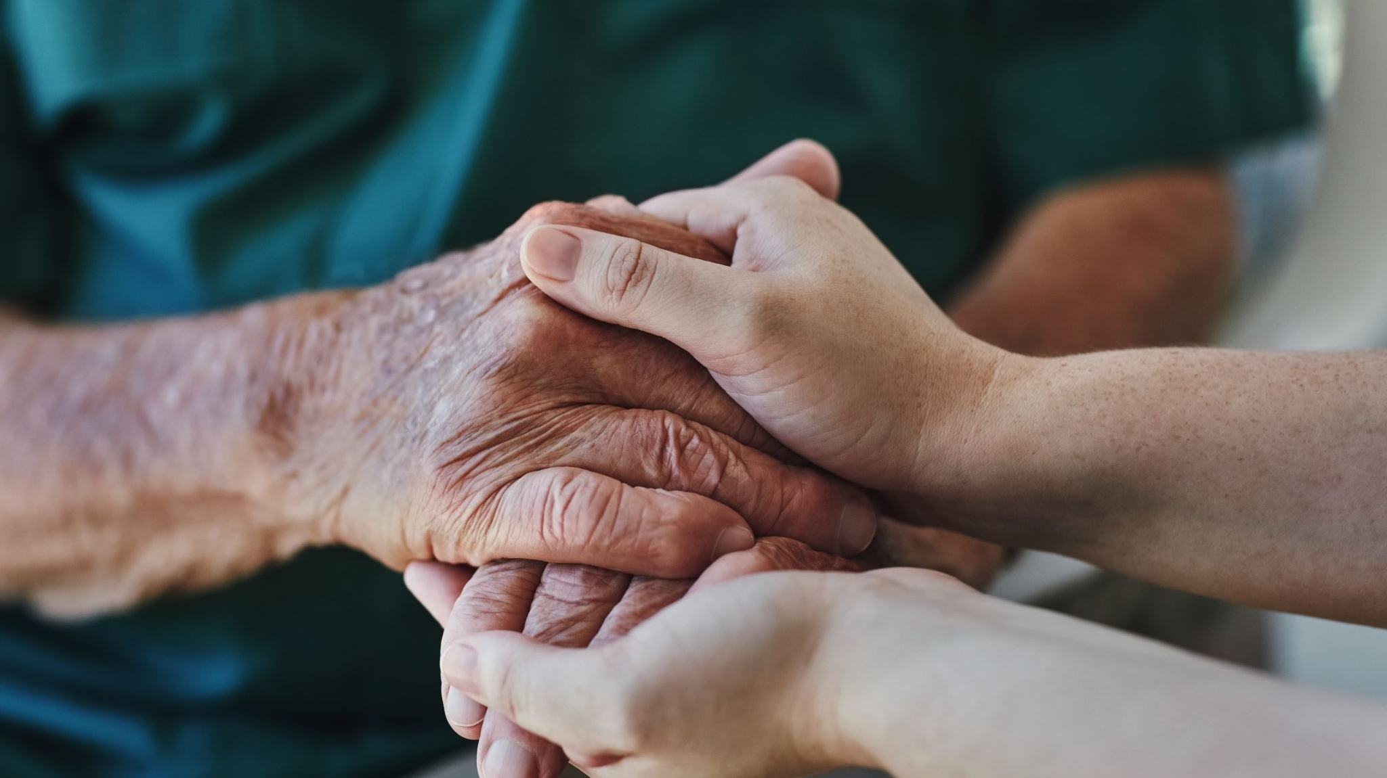
Attendance

Slide 97

Happy Learning and Bright Futures Ahead!
Dr. Farshid Keivanian
Stay Connected:
LinkedIn Profile: https://www.linkedin.com/in/farshid-keivanian
Education is the most powerful weapon you can use to change the world. — Nelson Mandela

